Slide 1
Exploratory Data analysis of cab service data
Rodrigo Tumani Soubhia Giesteira
11/18/2023

Slide 2
Introduction
This presentation has the objective to explore datasets on the cab industry, specifically, the companies Pink Cab and Yellow Cab Provide, and provide actionable insights to help XYZ firm identify the right company for making an investment.
The analysis has been divided into four parts:
Data Understanding
Sharing relevant findings on profitability and customer retention
Finding the Cab Company With Biggest Growth Potential
Recommendations for investment

Slide 3
Overview of Datasets
The datasets used in this analysis and the relevant columns in them are:
Cab_Data.csv: Company, Dates, Distance, City, Price Charged, Cost, Transaction ID
Customer_ID.csv: Customer ID, Gender, Age, Income
Transaction_ID.csv: Transaction ID, Customer ID, Payment mode
City.csv: City, Population, Users
The datasets presented no Missing Values.

Slide 4
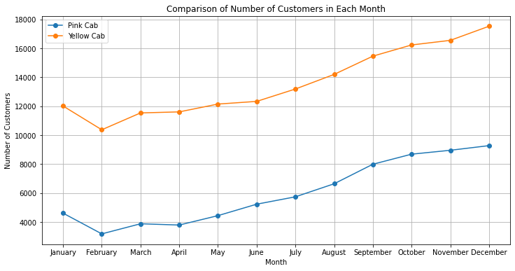
Customer Trends
The Graph shows relevant information on the seasonality in the number of customers. Yellow Cab shows a greater number of customers year-round, with both companies having the peak month of customers in December

Slide 5
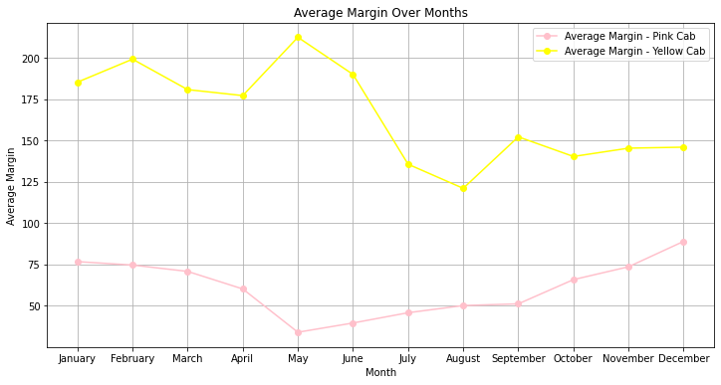
Profitability Analysis
The graph shows that Yellow Cab has a greater profit margin year-round.
It is noticeable that Pink Cab’s profit margin remained more constant over the months, with significant growth at the end of the year.

Slide 6
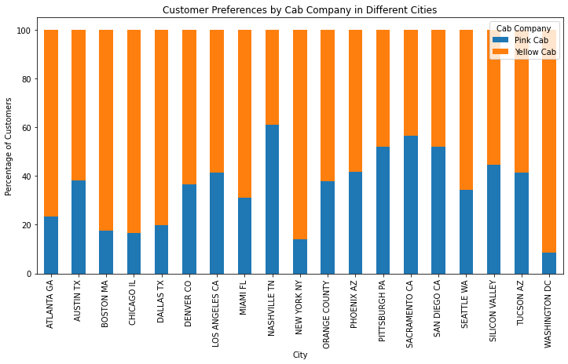
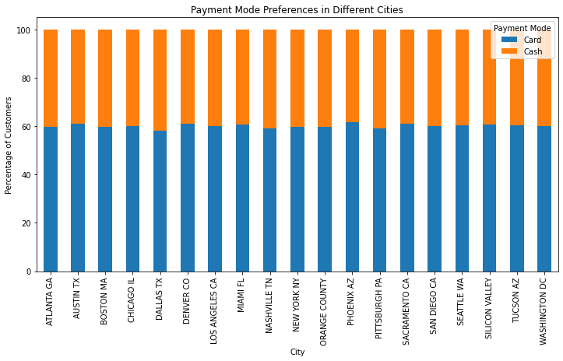
Customer Preferences

Slide 7
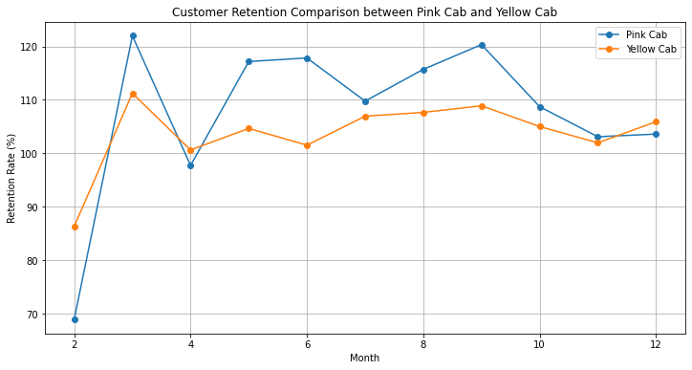
Customer Retention
The graph shows great fluctuation in customer retention rate throughout the year, with both companies ending the year with approximately 105% retention rate

Slide 8
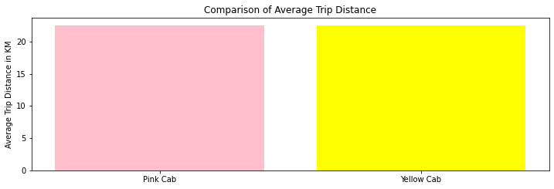
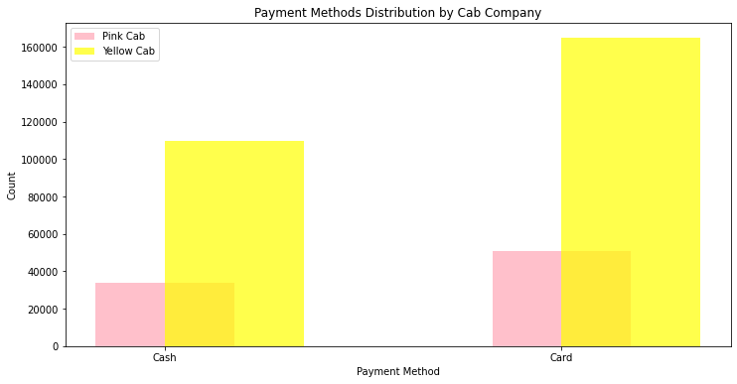
Impact of TRIP DISTANCE and payment methods

Slide 9
Conclusion
Key Findings:
Customer Dynamics:
Explored customer trends, identifying peak months and variations in demand for both Pink Cab and Yellow Cab.
Noted distinct seasonal patterns influencing customer numbers.
Profitability Analysis:
Examined the average profit margins for Pink Cab and Yellow Cab, uncovering potential areas for improvement.
Customer Preferences:
Investigated customer preferences across different cities, shedding light on service adoption and payment methods.
Customer Retention:
Compared customer retention rates between Pink Cab and Yellow Cab, providing insights into long-term customer relationships.
Profitability Drivers:
Explored the impact of trip distance and payment methods on the profitability of both cab companies.

Slide 10
Recommendation
After cautious consideration and analysis, my recommendation for XYZ is to invest in Yellow Cab company, here are some of the reasons why:
Yellow Cab shows a greater number of customers and an increase in this number throughout the year.
Yellow Cab shows a greater profit margin year-round.
Customers show a preference for Yellow Cab over Pink Cab in 13 out of 17 cities where both companies provide services.
Yellow Cab also surpassed Pink Cab in customer retention rate, showing a significant increase throughout the year.

Slide 11
Thank You!

